Slide 1
Module 1
Introduction to the Cloud

Slide 2
Outline
MODULE 1 INTRODUCTION
  Welcome to AWS Cloud Practitioner Essentials
THE AWS CLOUD
  What is Cloud Computing?
  Benefits of the AWS Cloud
  Introduction to AWS Global Infrastructure
  The AWS Shared Responsibility Model
CLOUD IN REAL LIFE
  Applying Cloud Concepts to Real Life Use Cases

Slide 3
What is Cloud Computing?

Slide 4
In this lesson, you will learn:
Define cloud computing.
Describe and differentiate between cloud deployment types.

Slide 5
Defining cloud computing
It is on-demand delivery of IT resources over the internet with pay-as-you-go pricing:
On-demand delivery
  On-demand delivery means that customers can access computing resources, such as storage or compute power, within seconds and as needed.
  Users can scale their resource usage up or down based on current requirements without lengthy provisioning processes.
of IT resources
  The of IT resources aspect highlights the wide array of information technology assets in the cloud-computing space.
  These resources include servers, storage solutions, databases, networking components, artificial intelligence and machine learning (AI/ML) tools, and more.
  Customers can use these resources to build, deploy, and manage applications and services through the cloud infrastructure.

Slide 6
Defining cloud computing
over the internet
  Over the internet signifies that cloud computing delivers IT resources through internet connectivity.
  This means that users access and use these resources through web-based services rather than maintaining local hardware or software.
  The internet acts as the conduit, which provides remote access to compute power, storage, and applications from anywhere in the world.
with pay-as-you-go-pricing
  Flexible pricing is a fundamental economic aspect of cloud computing.
  Users pay only for the resources they actually consume, rather than committing to fixed, long-term contracts.
  This usage-based pricing model offers cost efficiency and financial flexibility.

Slide 7
Cloud deployment types
Cloud
  In a cloud-based deployment model, you have the flexibility to migrate your existing resources to the cloud, design and build new applications within the cloud environment, or use a combination of both.
  For instance, a company might migrate data resources to the cloud, then develop an application comprised of virtual servers, databases, and networking components entirely hosted in the cloud.
On-premises
  Deploying resources on premises using virtualization and resource management tools does not provide many of the benefits of cloud computing.
  However, it is sometimes sought for its ability to provide dedicated resources and low latency.
  In most cases this deployment model is the same as legacy IT infrastructure while using application management and virtualization technologies to try increasing resource utilization.

Slide 8
Cloud deployment types
Hybrid
  In a hybrid deployment, cloud-based resources and on-premises infrastructure work together. This approach is ideal for situations where legacy applications must remain on premises due to maintenance preferences or regulatory requirements.
  For instance, a company might choose to retain certain regulated legacy applications on-premises while using cloud services for advanced data processing and analytics.
  Multi-cloud deployments can also be considered hybrid deployments.

Slide 9
Benefits of the AWS Cloud

Slide 10
In this lesson, you will learn
Describe the six key benefits of cloud computing.

Slide 11
The six key benefits of the AWS Cloud
Trade fixed expense for variable expense
  By using the AWS Cloud, businesses can transition from fixed investments to variable costs.
  With variable costs, customer expenses are better aligned with actual usage, thus creating more financial flexibility.
Benefit from massive economies of scale
  Like buying a product in bulk can result in lower prices per unit, the vast global infrastructure of AWS can result in lower costs for customers.
  This means that AWS can be used by many organizations, from small startups to major corporations.
  Businesses big and small can access advanced technologies that were previously only accessible to large enterprises.

Slide 12
The six key benefits of the AWS Cloud
Stop guessing capacity
  Customers can dynamically scale AWS Cloud resources up or down based on real-time demand.
  This means businesses can achieve optimal performance without provisioning more or less infrastructure than they need.
Increase speed and agility
  With the cloud, businesses can rapidly deploy applications and services, accelerating time to market and facilitating quicker responses to changing business needs and market conditions.

Slide 13
The six key benefits of the AWS Cloud
Stop spending money to run and maintain data centers
  The AWS Cloud eliminates the need for businesses to invest in physical data centers.
  This means customers aren't required to spend time and money on utilities and ongoing maintenance.
  With AWS taking care of the physical infrastructure of the cloud, customer resources can be reallocated to more strategic initiatives.
Go global in minutes
  Businesses don't need to set up their own infrastructure to expand internationally.
  AWS provides a robust global infrastructure that customers can use to deploy applications and services across multiple areas in minutes.

Slide 14
Introduction to AWS Global Infrastructure

Slide 15
In this lesson, you will learn:
Define AWS Regions and Availability Zones.
Explain the benefits of high availability and fault tolerance.

Slide 16
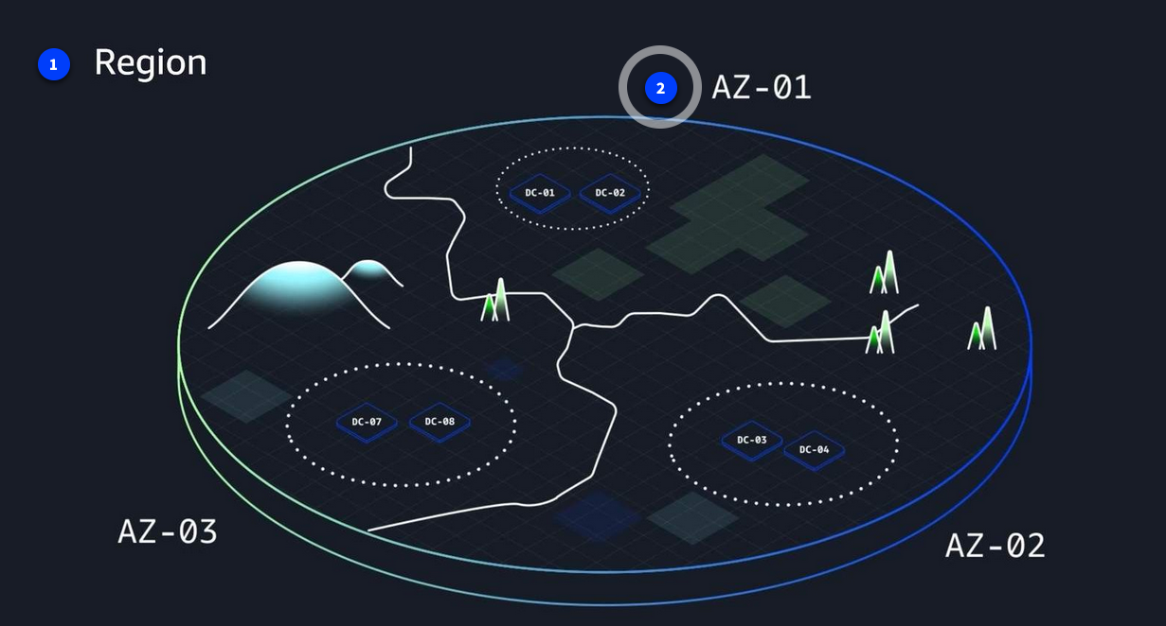
AWS Regions and Availability Zones
AWS Global Infrastructure consists of physical locations around the world that contain groups of data centers.

Slide 17
AWS Regions and Availability Zones
AWS Regions
  AWS Regions are physical locations around the world that contain groups of data centers.
  These groups of data centers are called Availability Zones.
  Each AWS Region consists of a minimum of three physically separate Availability Zones within a geographic area.
Availability Zones
  An Availability Zone consists of one or more data centers with redundant power, networking, and connectivity.
  Regions and Availability Zones are designed to provide low-latency, fault-tolerant access to services for users within a given area.

Slide 18
Achieving high availability with AWS Global Infrastructure
AWS infrastructure is designed with high availability and fault tolerance in mind.
Availability Zones (AZs) are configured as isolated resources, and they are each equipped with independent power, networking, and connectivity.
It's recommended to distribute your resources across multiple AZs.
That way, if one AZ encounters an outage, your business applications will continue to operate without interruption.
With this approach of redundancy and resource isolation, AWS customers can achieve the benefits of high availability and fault tolerance.

Slide 19
The AWS Shared Responsibility Model

Slide 20
In this lesson, you will learn
Describe and differentiate between customer responsibilities, AWS responsibilities, and shared responsibilities in the AWS Cloud.
Describe the components of the AWS Shared Responsibility Model.

Slide 21
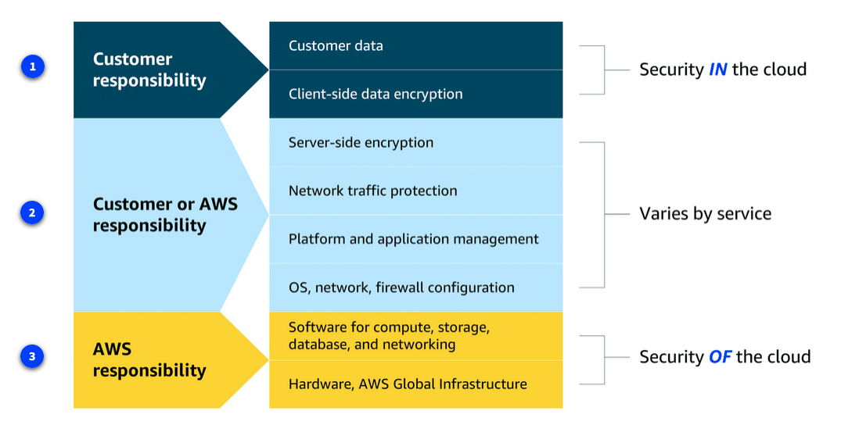
Components of the AWS Shared Responsibility Model
Customer responsibilities
  Customers are responsible for managing security requirements for their data, including which data they store on AWS and who has access to that data.
  Customers also control how access to the data is granted, managed, and revoked.
  Additionally, customers are responsible for client-side encryption.

Slide 22
Components of the AWS Shared Responsibility Model
Shared responsibilities
  Depending on the service used, responsibilities might shift between the customer and AWS.
  Components such as server-side encryption, network traffic protection, platform and application management, and OS, network, and firewall configuration vary by service in terms of who is responsible for these items.
  As you learn more about different types of services, you will see specific examples of how these elements are divided between the customer and AWS.

Slide 23
Components of the AWS Shared Responsibility Model
AWS responsibilities
  AWS is responsible for protecting the infrastructure that runs all of the services offered in the AWS Cloud.
  This infrastructure is composed of the hardware, software, networking, and facilities that run AWS Cloud services.

Slide 24
Applying Cloud Concepts to Real Life Use Cases

Slide 25
In this lesson, you will learn
Explain how fundamental cloud concepts, such as the AWS Global Infrastructure and AWS Shared Responsibility Model, work together to form real-world business solutions.

Slide 26
Cloud in real life: Infrastructure and shared responsibility
AWS Global Infrastructure – Real-World Impact
  Problem: An e-commerce company wants to expand globally.
  Customers in Europe and Asia need fast, reliable access.
  Solution with AWS:
    Deploy workloads in Regions close to customers (e.g., eu-west-1 in Ireland, ap-southeast-1 in Singapore).
    Reduce latency by leveraging AWS’s pre-built global footprint.
    Startups benefit since they don’t need to build or buy data centers in those geographies cloud lowers the barrier to global reach.

Slide 27
Cloud in real life: Infrastructure and shared responsibility
High Availability & Fault Tolerance
  Problem: E-commerce apps can’t afford downtime—one AZ outage should not kill the website.
  Solution with AWS:
    Deploy in multiple Availability Zones (AZs) within a Region.
    If one AZ goes down, traffic can fail over to another.
    This design provides fault tolerance and high availability without building redundant physical data centers.

Slide 28
Cloud in real life: Infrastructure and shared responsibility
Shared Responsibility Model
  Problem: Who handles security for global expansion—AWS or the customer?
  Solution with AWS:
    AWS responsibility (“of the cloud”) → securing physical infrastructure (data centers, networking, hardware).
    Customer responsibility (“in the cloud”) → securing applications, configurations, user access, and compliance with standards (like PCI DSS for credit card data).
    This split allows businesses to focus on business-critical security instead of racking servers or guarding facilities.

Slide 29
Recap
In this section of the training, you learned fundamental concepts of cloud computing.
You explored the definition and benefits of the cloud, and you were introduced to AWS Global Infrastructure.
You also explored the AWS Shared Responsibility Model to clarify the division of responsibilities between AWS and customers.

Slide 30
Resources
Resource link | Description
What is Cloud Computing? | Learn more about the basics of cloud computing.
AWS Shared Responsibility Model | Learn more about the AWS Shared Responsibility Model.
Regions and Availability Zones | View a complete list of AWS Regions.

